Slide 1


Russian Particle Accelerators Conference RuPAC'23
ByPass NICA for QFS
RuPAC’23
Novosibirsk, 2023.
1
04/07/2023
1
05/09/2023
Dubna, 2023.

Slide 2
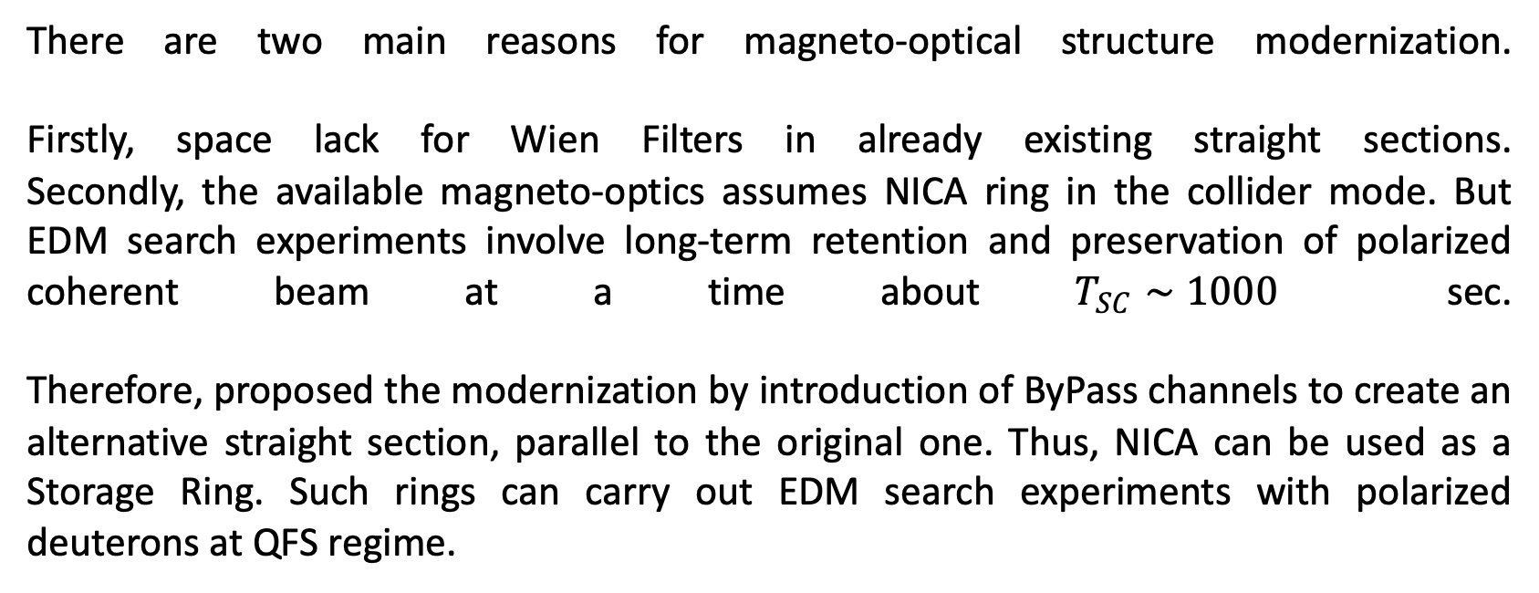
Reasons of modernization
There are two main reasons for magneto-optical structure modernization. Firstly, space lack for Wien Filters in already existing straight sections. Secondly, the available magneto-optics assumes NICA ring in the collider mode. But EDM search experiments involve long-term retention and preservation of polarized coherent beam at a time about $T_{SC}∼1000$ sec.
Therefore, proposed the modernization by introduction of ByPass channels to create an alternative straight section, parallel to the original one. Thus, NICA can be used as a Storage Ring. Such rings can carry out EDM search experiments with polarized deuterons at QFS regime.
RuPAC’23
Novosibirsk, 2023.
05/09/2023
2

Slide 3
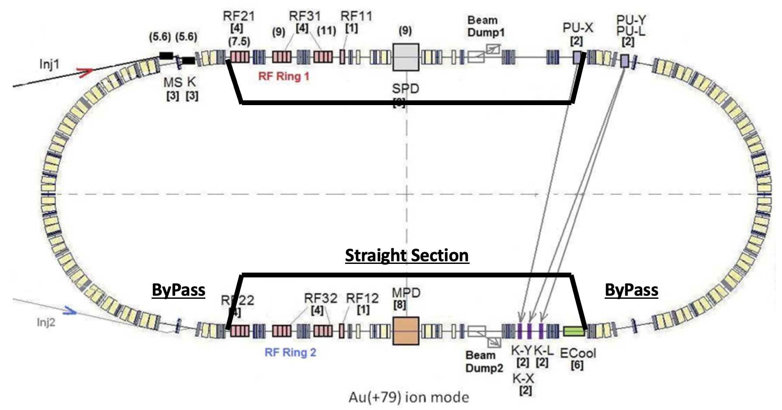
General NICA ByPass Concept
RuPAC’23
Novosibirsk, 2023.
05/09/2023
3

Slide 4
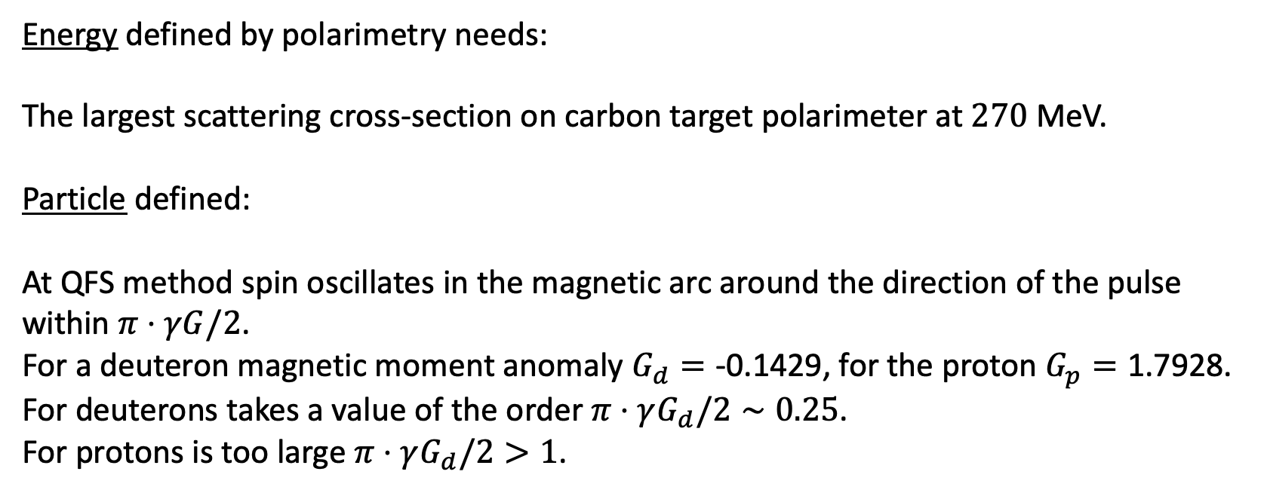
Particle & Energy
Energy defined by polarimetry needs: The largest scattering cross-section on carbon target polarimeter at $270$ MeV.
Particle defined:
At QFS method spin oscillates in the magnetic arc around the direction of the pulse within $π⋅γG/2$.
For a deuteron magnetic moment anomaly $G_{d}=\text{-0.1429}\text{, }$for the proton $G_{p}=\text{1.7928}$.
For deuterons takes a value of the order $π⋅γG_{d}/2∼0.25$.
For protons is too large $π⋅γG_{d}/2>1$.
RuPAC’23
Novosibirsk, 2023.
05/09/2023
4

Slide 5
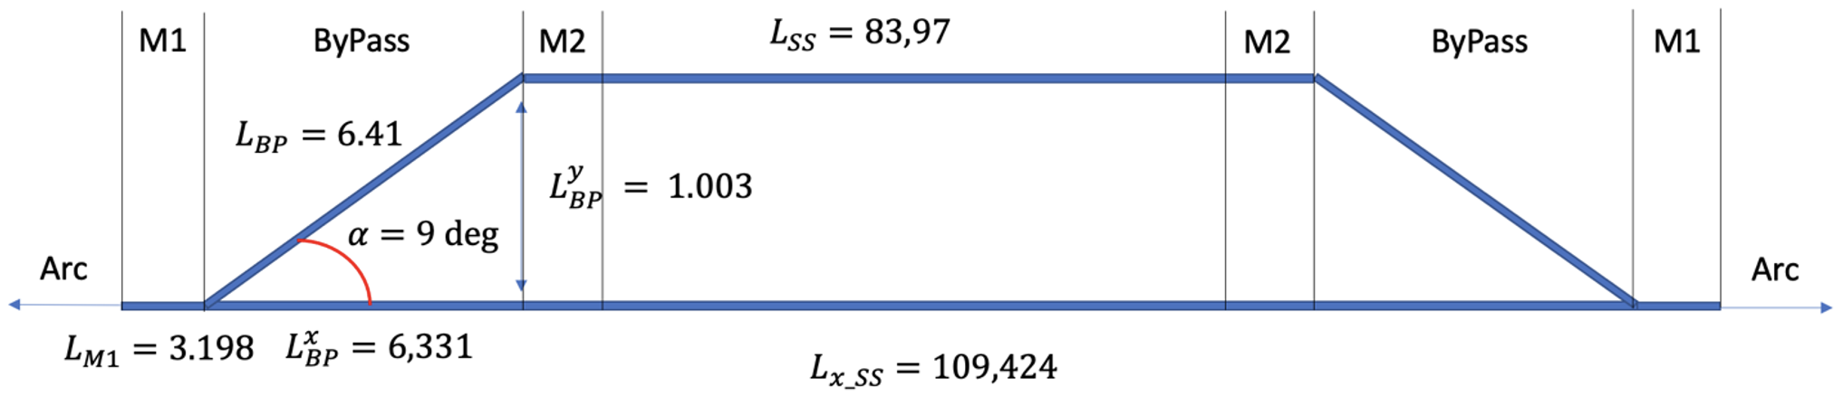
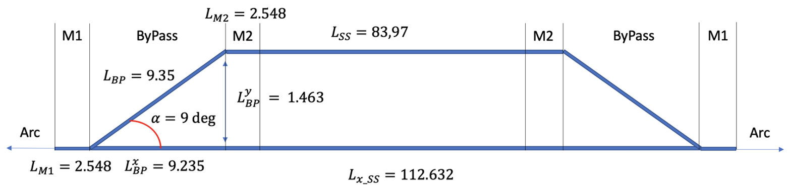
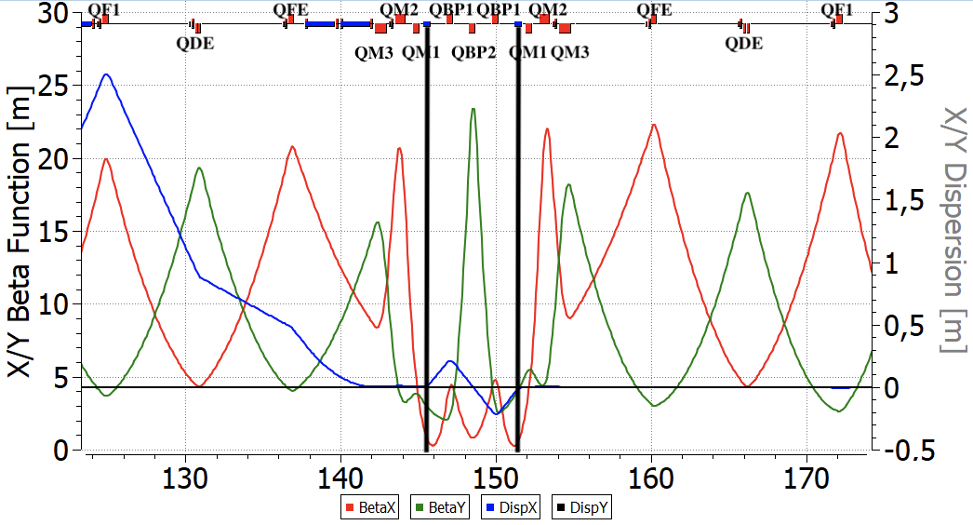
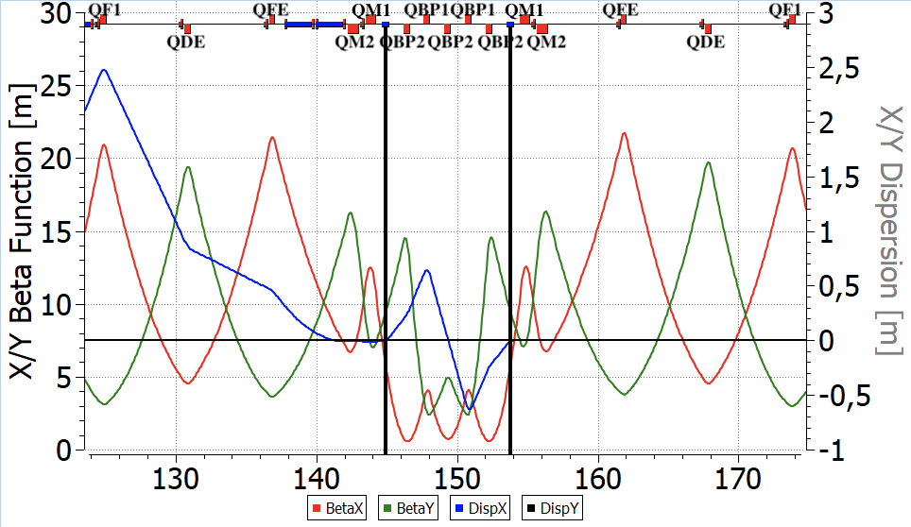
Possible ByPass Optics
3 Quadrupoles
5 Quadrupoles
RuPAC’23
Novosibirsk, 2023.
05/09/2023
5

Slide 6
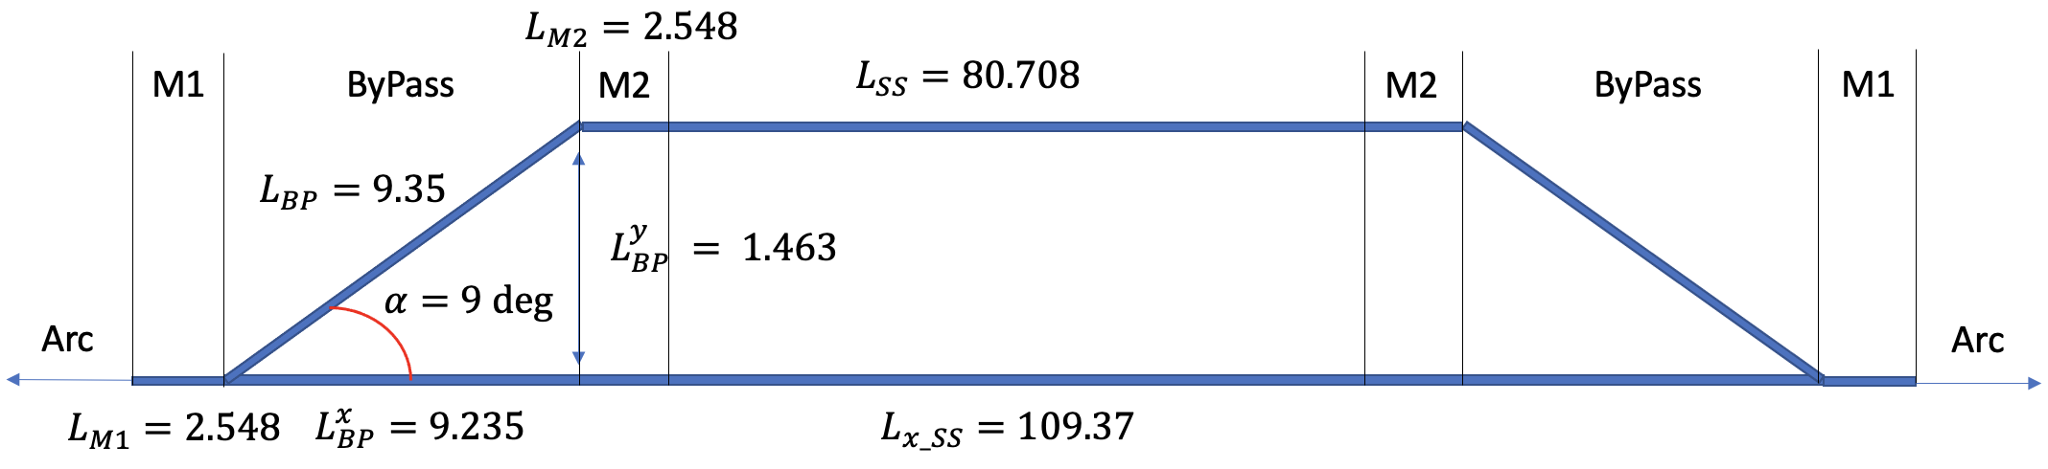
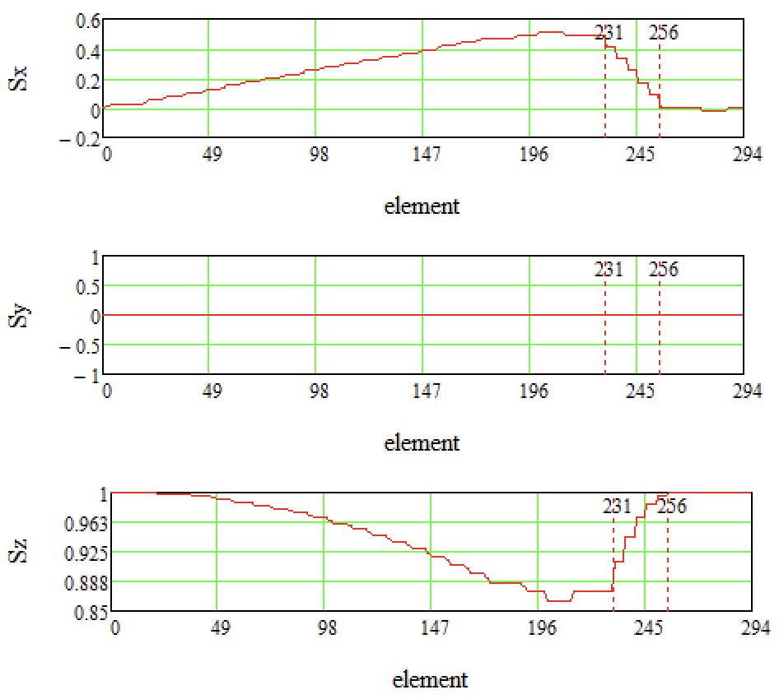
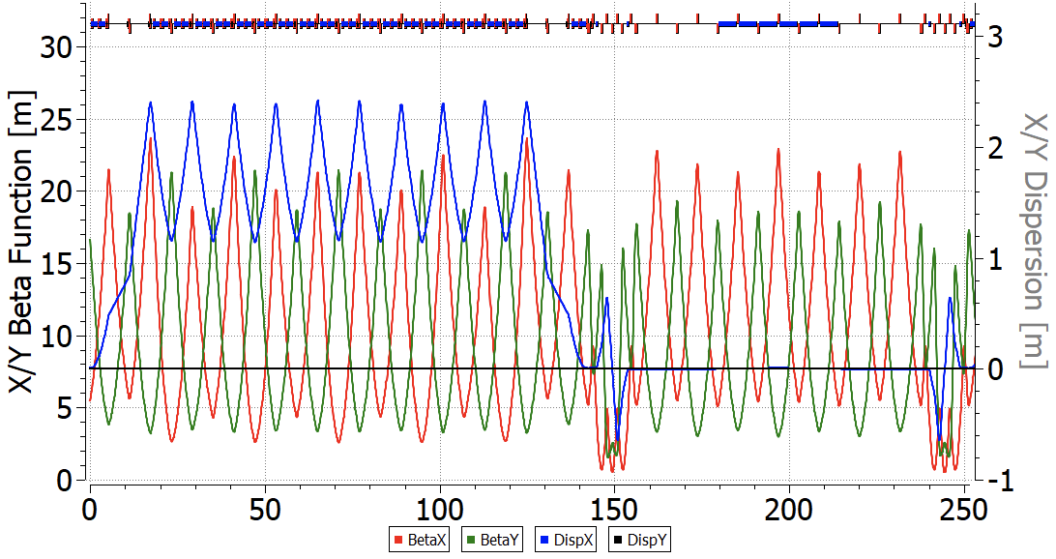
Fully adopted Twiss-functions with Wien Filters
Straight Section is Fully Regular
Straight Section Wien Filters restore spin rotation in Arc
RuPAC’23
Novosibirsk, 2023.
05/09/2023
6

